Slide 1
SOAP Web Services

Slide 2
Web Services - Definition from W3C
“ A Web service is a software system identified by a URI, whose public interfaces and bindings are defined and described using XML. Its definition can be discovered by other software systems. These systems may then interact with the Web service in a manner prescribed by its definition, using XML based messages conveyed by internet protocols.”

Slide 3
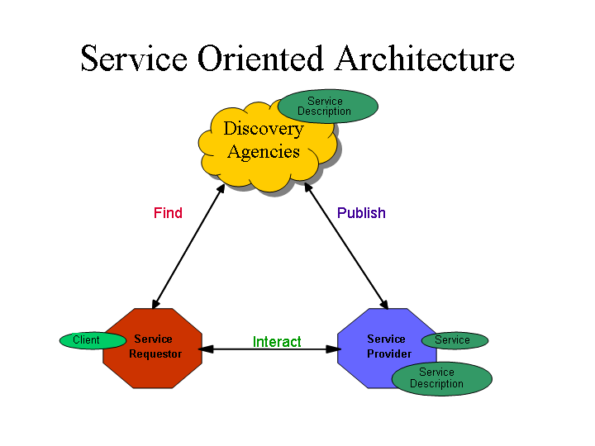
Service Oriented Architectures
Role
Technologies capable of:
Exchanging messages
Describing Web services
Publishing and discovering Web service descriptions
service requestor retrieves a service description
A service publishes its description
Operation
One-way, conversational, many-to-many
Component

Slide 4
Web Services –
Architectural Extensions
  Incorporates additional features and functionality by extending technologies and components defined within the basic architecture, such as:
    Asynchronous messaging
    Attachment – typical usage : associating binary data with SOAP messages.
    Caching
    Message exchange pattern (MEP) - Describes a generalized pattern of message exchange between two services. e.g. : one-way, request/response, publish/subscribe, and broadcast.
    Reliable message - implementation of Reliable Messaging one MEP is a series of requests between two nodes with an acknowledgement SOAP Module.
    Message confidentiality – Can transmit the message via SSL or TLS, or have a SOAP Module provides for encryption and decryption.
    Message integrity – Can have a SOAP Module use digital signature.
    Session

Slide 5
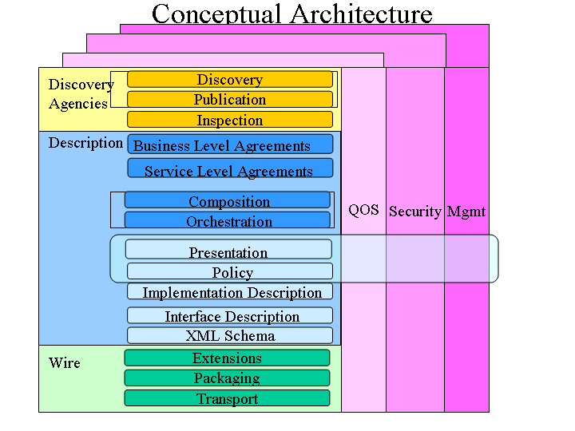
The Complete Web Services "Stack"
More
mature
technologies

Slide 6
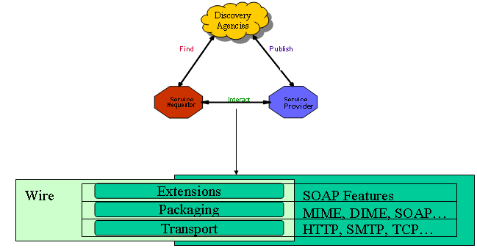
The Wire Stack
Transport: HTTP is the de facto, other may be supported.
Packaging: SOAP is the de facto standard for XML messaging.
Extensions : Additional information attached to web services messages.

Slide 7
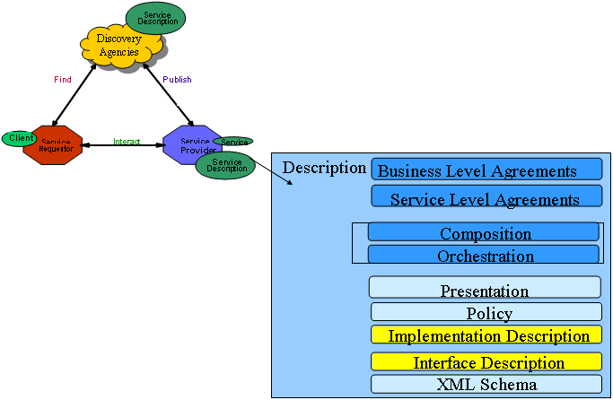
The Description Stack
It is actually a stack of description documents defined using XML Schema.
Not fully
specified
facts, or assertions, and
rules that apply to a
particular Web service
Input/
Output
rendering
minimum service description
necessary to support
interoperable Web services.
Satisfied
by WSDL

Slide 8
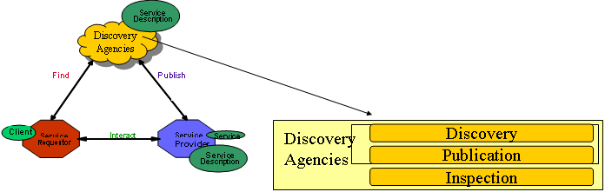
The Discovery Stack
WSIL : de-centralized service discovery method
  Service can be published using a variety of mechanisms:
    Direct publish: description sent directly to requestor;
    WSIL : HTTP GET retrieves descriptions from URL;
    Universal Description, Discovery and Integration (UDDI) registries: a Web-based distributed directory.
  Service requestors can retrieve a service description at design time (search by interface) or runtime (by communication and QoS) from a Web page (URL), a service description repository, a simple service registry or a UDDI registry. Discovery depends on how services are published;

Slide 9
The technology so far
  The WS technology is completely based on XML. Therefore, both the data format and the interaction protocols are XML-based:
  customized XML -> data format
  SOAP -> communication protocol
  WSDL -> the Interface definition language
  WSIL/UDDI -> standards for services discovery
  The lowest-level layers (the transport layer) should exploit some existing Internet protocols, like HTTP or SMTP

Slide 10
What is XML?
  XML is a simple tag-based language for describing information in a structured way.
  Basic elements:
  Tags
  Attributes
  Text
LastName
Allen
StartTag
Attributes
Text
EndTag
<xhtml:table><xhtml:tr>
<xhtml:td width="40%">LastName</xhtml:td>
<xhtml:td width="60%">Allen</xhtml:td>
</xhtml:tr></xhtml:table>

Slide 11
How to work on XML
The tree-like structure of XML makes developers life hard.
  In practice there is not a standard way for editing and analyzing, but the best method depends on your need. Just choose among:
  SAX -> callback-based parser
  DOM -> tree representation
  XSLT -> “XML to XML” conversion
  XPATH -> queries
  XML Binding -> transparent conversion to objects

Slide 12
Simple Object Access Protocol
SOAP is a technology to support the exchange of XML-coded messages over a transport protocol, such as HTTP and SMTP. (wire stack)
HTTP
Client
Server
SOAP
  XML
XML  
XML
Stub
Skeleton
  SOAP
SOAP  
POST…
HTTP client
HTTP server
Protocols Folding
HTTP 1.1 200 OK
SOAP basic mechanism

Slide 13

Simple Object Access Protocol
A SOAP runtime engine basically adds a XML envelope to an existing XML document
SOAP Envelope
<soap:Envelope>
<soap:Header>
<axis:SessionKey>
SDHH37TYEW7R7
</axis:SessionKey>
</soap:Header>
<soap:Body>
<GetPrice>
<Item>Apples</Item>
</GetPrice>
</soap:Body>
</soap:Envelope>
SOAP Header
Communication Info
Example
SOAP Body
XML Document
Document Container
Session, Authentication, Routing, Security

Slide 14
SOAP Encoding
Dealing directly with XML messages is not easy.
Therefore, SOAP provides a “RPC emulation” technology
The result: developers work with web services like with traditional RPC (e.g. CORBA,DCOM,DCE)
The “RPC emulation” is named SOAP encoding.
Fundamentally it is a set of rules to map a procedure invocation to a XML document.

Slide 15
SOAP Encoding
The rules:
  method name -> first level element in the SOAP Body
  arguments identifiers -> second level elements
  arguments values -> third level elements
  arguments types -> attribute xsi:type
ClockService.getTime(location="USA");
<soap:Body>
<getTime>
<location xsi:type="xsd:string">USA</path>
</getTime>
</soap:Body>
Service Request

Slide 16
Web Service Description Language
WSDL is a standard format to describe a Web Service (description stack)
A WSDL document is composed by two sections:
  An abstract interface section -> like in traditional IDL, it defines the signatures of procedures (RPC-style) or messages (document-style)
  A deployment section -> it defines the service location and the supported transport protocols
  Fundamentally a client uses the WSDL to create the stub or to dinamically decode messages.

Slide 17
Web Service Introspection Language
WSIL and UDDI are the standard way to search Web Services. (Discovery stack)
WSIL is the decentralized approach.
Fundamentally a WSIL document contains a directory of the Web Services deployed on a server.
It is anologous to the index.html document for web pages.
In the future, specific crawlers will browse the Internet looking for WSIL documents, like Google does today for web pages.

Slide 18
Web Service Introspection Language
<inspection>
<abstract>Acme Industries Public Web Services</abstract> <service>
<name>Store Finder Service</name>
<abstract>
A service to perform a geographical search of Acme stores.
</abstract>
<description location="http://example.org/services/storefinder.wsdl"/>
</service>
<link location="http://example.org/services/ecommerce.wsil"/>
</inspection>
Service name
Link to an other WSIL page
Service location and description

Slide 19
UDDI
UDDI is a complimentary approach for searching based on a centralized repository.
The repository is an “electronic yellow pages” for firms that offer web services online. Besides the names of services and their WSDL descriptors, firms can add a description of their business, phone numbers, addresses...
UDDI repositories are offered by many agencies - e.g. IBM, Microsoft and HP.

Slide 20
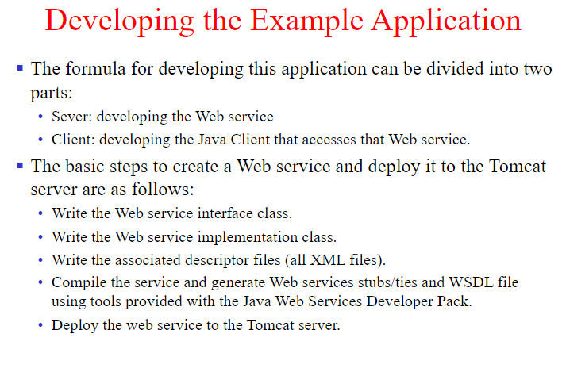

Slide 21
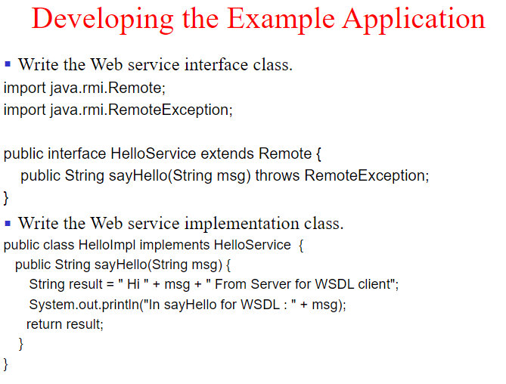

Slide 22
